Slide 1
PFA Diversity, Equity, and Inclusion Initiative
Fundamentals of Creating and Sustaining an Inclusive Environment

Slide 2
PFA Diversity, Equity & Inclusion Initiative (DEII) Train-The-Trainer TRAINING OBJECTIVE
Prepare you to train others to deliver an organized DEI program, based upon best-practice, and with readily-available options for customization
Learn the fundamentals of program structure and delivery
Explore a sample of the tools available to execute a DEI program
CUSTOMIZE THIS PAGE TO YOUR ORGANIZATION

Slide 3
Optional Member Organization Custom Slide
Ideas for this slide include but are not limited to:
Your organization’s Mission
Mission Statement for your own diversity, equity and inclusion initiative
How DEI fits into your goals, purpose, aspirations for the future, etc.
Supportive quote(s) from key leader(s) or notable member(s) of your organization
10 Examples and How to Write a DEI Mission Statement
Custom Mission Statement Sample

Slide 4
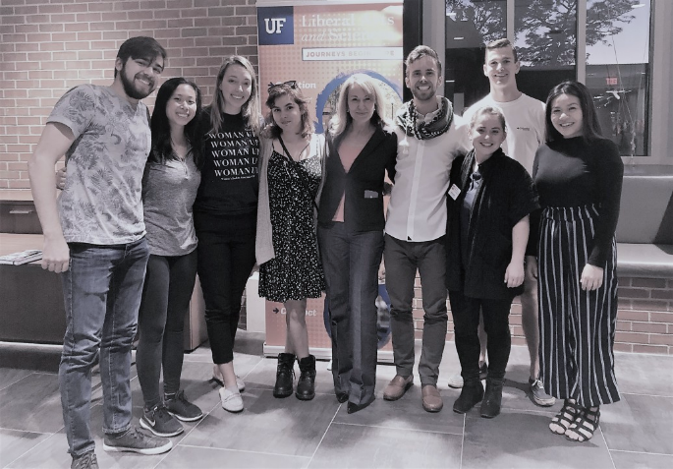
Brief Introductions
Your Name
Your Role
PFA Member Organization
Sunny Nastase
VersoriumIQ
sdnastase@gmail.com
678.699.3870
Linkedin.com/in/sunnynastase
CUSTOMIZE THIS PAGE TO YOUR INFORMATION

Slide 5
STRUCTURE
Harvard Implicit Bias Experience
Diversity Action Council + Set Targets
Activate + Communicate
Measure + Adjust

Slide 6
Section One
Harvard Implicit Bias Experience
Diversity Action Council + Set Targets
Activate + Communicate
Measure + Adjust

Slide 7
START WITH THE HARVARD IMPLICIT BIAS EXPERIENCE
Starting with implicit bias is a time-proven best practice
Shifts the focus to each of us and what we can do vs. focus on someone “out there”
Encourages individuals to share their own experience, getting more comfortable talking about realities of bias
Drives home the message that prejudice, discrimination and inequity are choices we all make
Provides every organization with data from which to make program decisions – can assign sub-groups
It’s actually Fun.

Slide 8
HARVARD IMPLICIT SITE
Phase I – Exploring Implicit Bias
Harvard Implicit Site
How Implicit Bias Tests Work
HARVARD IMPLICIT BIAS EXPERIENCE LINKS

Slide 9
IMPLICIT BIAS (Phase 1) SUMMARY
Review tools and documents on PFA DEII Phase 1 Web pages
Determine timeline and how to deliver (individual, watch parties or meetings, “Live” workshop…)
Promote for 2-4 weeks
Launch
Request Data
ASK SUNNY NASTASE AND RILEIGH ROBERSON FOR ANY SUPPORT NEEDED
CUSTOMIZE THIS PAGE AS APPROPRIATE

Slide 10
Section Two
Harvard Implicit Bias Experience
Diversity Action Council + Set Targets
Activate + Communicate
Measure + Adjust

Slide 11
DEI ACTION COUNCIL OVERVIEW
Sometimes called a Task Force, DEI Councils:
Actively develop and promote strategies and experiences to drive increased racial, religious, social, age, gender and other aspects of diversity
Seek to understand the issues and language of diversity, equity and inclusion
Provide advice, suggestions and opportunities to more traditional leadership to move diversity to the forefront
Take on accountability for change
Personify the message that the organization has a focus on increased diversity
Set and achieve real goals, and deepen impact over time
Do their utmost to include a full range of perspectives and demonstrate tolerance – even those with whom they disagree
Focus on change but also recognize the value of awareness, engagement, and a positive diversity experience
Endeavor to create a culture of true inclusion for minority individuals and groups, and one with active and engaged ALLIES

Slide 12
DIVERSITY, EQUITY, AND INCLUSION ACTION COUNCILS
RECOMMENDATIONS FOR COUNCIL MEMBERS | BEST COUNCILS HAVE THE FOLLOWING IN COMMON
Ask don’t Task, especially if looking for minority representation Is an influencer - if not a formal leader “Walks the Talk” Agrees to serve for ~2+ years Can handle tough conversations graciously/ demonstrates empathy skills Has solid attention to detail or has administrative support Bold, enjoys being visible | Have engaged stakeholders Have an established budget Over time, finds ways to include diverse members Over time, deepens and widens both scope and goals Make council service a visible, distinguished honor Encourage presentation to leadership groups Communicate time commitment per month and do “check Ins” (5-15 hours), adjust as necessary Make specific roles and deliverables clear and, if possible, measurable

Slide 13
Welcome and What’s Expected Email
Committee Best Practices
Draft 1st Agenda
PFA DEII Resources Web Page
Common Vernacular
DIVERSITY ACTION COUNCIL links

Slide 14
STAKEHOLDER OVERVIEW
Stakeholders are not your primary audience, but they play a primary role in your success. Who do you need for support and why? Know your Stakeholders and be strategic with them; find meaningful ways to communicate with them in cadence, over time.
Board of Directors | Human Resources | Volunteers
Organization Staff/Leaders | Alumni Groups | School Communications

Slide 15
STAKEHOLDER ENGAGEMENT
Stakeholders are key constituents that are not customers, but impact your program nonetheless
Mindful committee and stakeholder strategies are vital to success
Cultivate these relationships
Find out what’s important to them
Maintain communication / key developments updates
Solicit their perspective on what is working / what is not
Not every organization will have all Stakeholder groups engaged: Choose Wisely
Watch Out: Avoid taking for granted. Drift over time can lead to de-funding

Slide 16
Stakeholder Planning Worksheet
Draft 1st Agenda
Data Gathering Worksheet
Stakeholder Articles
STAKEHOLDER ENGAGEMENT LINKS

Slide 17
…AND A BIT ABOUT ADVOCATES
Also called a Champion or Liaison
Will be either be part of Stakeholder group or will have access to (and trust with) key Stakeholders. Can be one or more than one.
Not every Diversity Action Council must have an advocate, but they can be very powerful assets, especially in the beginning or times of crisis. Who should serve?
Has a passion for the subject of DEI; may have observed or experienced inequity personally
Will help you zero in on what your stakeholder will resonate with in content, format, style
Will help you rehearse for Stakeholder meetings
Will attend Council meetings or DEI events periodically
Can advise on “watch outs”, opportunities, deadlines, etc.
Praise, thank, give specific feedback!
Ensure advocates know what you need from them. Don’t overstep or overburden. Have frequent touch-ins and twice-yearly formal meetings to discuss how it’s going and what can be improved.

Slide 18
SET TARGETS
Engagement Targets & Program Goals should be linked to what your organization and your council intend to impact
Engagement Targets are transactional measures of activities and engagement
# events or activities
# attendees at events or activities
# “unique” participants
satisfaction on polling
Program Goals are long-term measures of true Impact of the activities and engagement
# minority representatives in various positions
Change in diversity of members, volunteers, minorities in leadership, vendors, change in complaints or compliments
“Observation” is an acceptable, verifiable form of measurement
Absolutely measure race but also beyond race to include disability, sexual orientation, religion, weight, age, country of origin

Slide 19
Annual Program Goals Declaration
Mature Program Example
Goal Setting Worksheet
Early Program Example
SET TARGETS LINKS

Slide 20
DIVERSITY ACTION COUNCIL + SET TARGETS SUMMARY
Action Council
Recruit
Stakeholders
Identify
Optional Advocate(s)
Identify and recruit
Targets
Activate!
Meet
Roles
Encouragement
Set calendar dates and GO
Needs & interests
Relationships
Needs & interests
Budget
Relationships
Needs & interests
Expectations
Set meeting cadence
Determine data to collect
Articulate key areas of interest
Set targets with Action Council
Communicate
Launch your events and activities
Track your progress

Slide 21
Section Three
Harvard Implicit Bias Experience
Diversity Action Council + Set Targets
Activate + Communicate
Measure + Adjust

Slide 22
ACTIVATE AND COMMUNICATE OVERVIEW
Activation consists of events, programs, social events, postings, social gatherings, celebrations, recognition…it is engagement
Activation is the backbone of your program what you will be known for, how people will experience DEI in real time
Activities, events and communication are driven by targets, punctuated by awareness, encouraging diversity interaction, and fun
Modes include:
One off events
Series events
Films and discussion
Book clubs and discussion
Lectures / panels / workshops
Social gatherings
Community outreach, community participation
Activation can be solution oriented such as Business Resource Groups (BRG’s) and Mentoring Programs
Communication can exist without activation, but activation cannot occur without communication

Slide 23
ACTIVATE & COMMUNICATE
PROGRAMMING
Don’t wait for the perfect annual calendar to “get busy” - START
Clearly assign goals of every program and how it will be advertised, who will support
Be willing to pay for quality speakers, locations, food, swag
Holidays and national diversity events are an excellent ways to communicate a welcoming environment
Utilize volunteers, parents, stakeholders, advocates, allies and community organizations to drive participation, especially early in your program activation
Assign Social Media Maven to photograph, post; ensure permissions at sign up
WATCH OUTS: Be cautious of highlighting individuals in the cancel culture unless time-proven. Do not feel compelled to reactively address social injustice issues when they arise. Instead, have a planned approach, talking points, and who will take the lead
Notes:
There are many ways to attack a training like this. There are many ways to engage in a deep DEII initiative, and good literature on programming that’s available to you online. However, the approach I’m taking is a very practical one, since many of the programs will actually be implemented out in the field, in local settings, by inexperienced volunteers. (check this with Joan) So, I’ve designed this approach not to make you a DEII expert but rather, to help you kick off activities for your students and fellow employees in a straightforward way that can be put into place fairly simply. You can see here, in this hour we will cover just 4 key steps: PREPARATION, ORGANIZATION, COMMUNICATION AND IMPLEMENTATION. Part 5 is a tool kit of resources and activities that you’ll find to be helpful in streamlining your efforts.

Slide 24
Monthly Planning Template
Activity Planning Worksheet
DEI Global Diversity Credential Program
Role of Mentoring Programs
Turnkey and Custom Workshops
2021 Diversity Calendar(s)
ACTIVATE LINKS

Slide 25
Comm. Plan Worksheet (who, why, how, when, what)
Branded Logo/Image Bank
Newsletter Template
Communication links

Slide 26
ACTIVATE + COMMUNICATE SUMMARY
Take a tour of available resources within this presentation and within the PFA DEII web pages
Considering organization goals and budget and set up a calendar of activities that vary in format
Photos, social media posts, newsletters, posters… make it visible
Maintain communications with key constituent groups
BUILD MOMENTUM WITH ATTENDEES AND VOLUNTEERS TO SUPPORT EVENTS
COLLABORATE WITH OTHER MEMBER AND COMMUNITY ORGANIZATIONS

Slide 27
Section Three
Harvard Implicit Bias Experience
Diversity Action Council + Set Targets
Activate + Communicate
Measure + Adjust

Slide 28
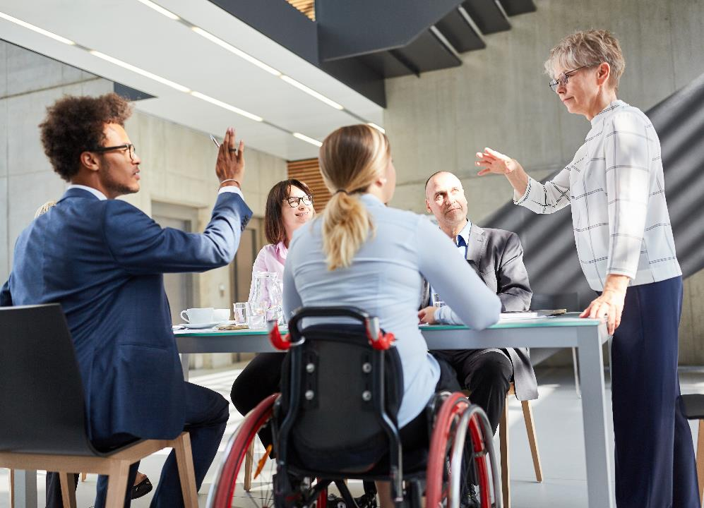
MEASURE + ADJUST OVERVIEW
Measure everything, share balanced results
Programs not measured risk being cancelled or defunded
Keep moving the bar – grow and stretch over time
Focus on what is working but try what is new, don’t give up on where you are falling short
Get constant feedback from various constituent groups, not just those that agree with you

Slide 29
Annual Feedback Workshop Agenda Including Key Accomplishments
Areas of Improvement
Thematic Feedback
MEASURE AND ADJUST ANNUALLY LINKS

Slide 30
MEASURE + ADJUST SUMMARY
Be very clear about what to track and what groups will see what results
Set up a range of measurement types
Measure and maintain data with unwavering discipline
Hold periodic meetings to evaluate and adjust, avoid “knee jerk” changes
Increase complexity over time. Take on deeper issues over time. Shed what is not working

Slide 31
Thank you!

Slide 32
Q&A

